Slide 1
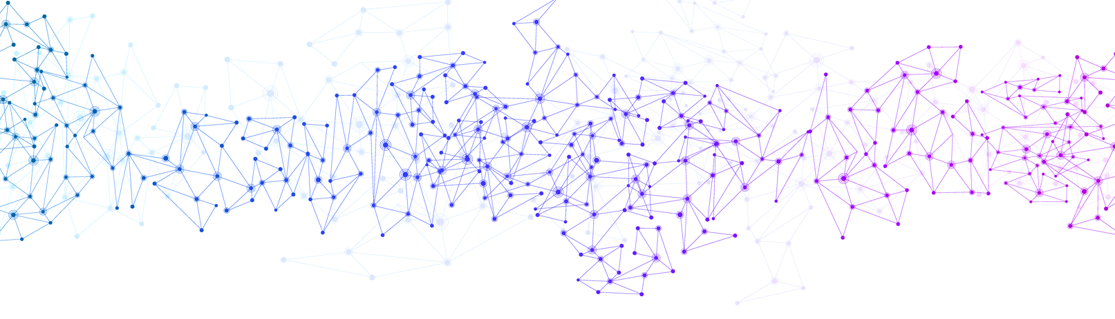



Welcome to the Baraza on
Considering Social Impacts in Design
Christopher A. Mattson, Christopher S. Mabey, Marin J. Fisher, John L. Salmon
Department of Mechanical Engineering
Brigham Young University, Utah, USA

Slide 2




Chris Mattson
Chris Mabey
Marin Fisher
John Salmon

Slide 3
Baraza Goal
To more deeply consider the impacts that engineered products can have on society
To support this:
We have some instruction (~20% of the baraza)
We have 4 activities presented in workshop format (~80% of the baraza)
We encourage participation in the activities, the zoom chat, and discussion
We encourage an ideation/brainstorming mindset, where
  The goal is not to agree but to explore
  The goal is not to challenge in an academic way, but to be constructive in a designerly way.

Slide 4
Baraza Goal #2
To provide you with the materials to bring these ideas to your classroom/teams
To support this:
We have workshop materials available to you at design.byu.edu
  The slides from this workshop (with presenter notes), for your use
  Social Impacts Consideration List (PDF)
  References to pertinent literature

Slide 5
PART 1
Short Orientation
PART 2
Impact Activities (4)
PART 3
Workshop Materials
Notes:
Workshop outline

Slide 6
Sustainable Design
Notes:
We are in pursuit of sustainable design. Let this be a foundation for our workshop. Something we can all get behind.

Slide 7
$$
Economic
Impact
Environmental
Impact
Social
Impact
Notes:
There are many ways to view sustainable design, and may philosophies. We will adopt the philosophy of the triple bottom line for this workshop. Which is that sustainable design seeks desirable impacts economic, environmental, and social areas.
All of these impact areas are important. The least formalized, however, are the impacts engineered products have on society. We will focus solely on social impacts for this workshop.

Slide 8
The impact of engineered products
on the day-to-day lives of persons
Social
Impact
Notes:
To be clear, we will use this simple definition of social impacts.

Slide 9
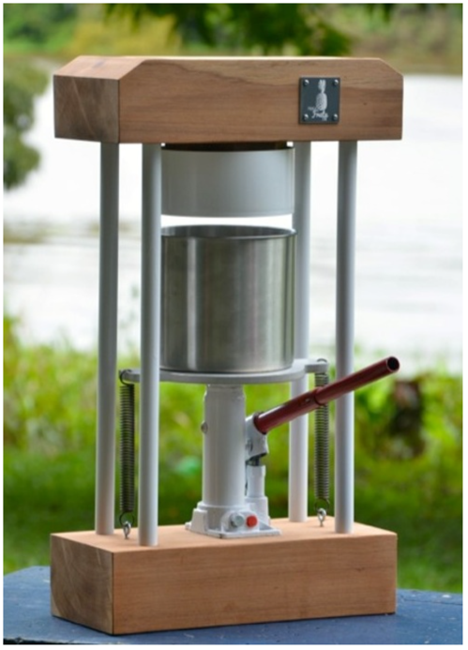
Fruit Press
Possible Social Impacts
Allows fruit to be processed before it spoils
Supports skilled labor growth
Creates a worker safety risk
Could create new business opportunity
Might change the way people consume fruit
Could be a piece of equipment worth stealing
Notes:
As an example, consider this simple fruit press. It was designed to address the problem of pineapples spoiling before purchased at the market. A community in Brazil harvests 80,000 pineapples a day. 10s of thousands are wasted daily because they cannot make it to the markets fast enough. Once ideas for addressing this problem is to produce pineapple juice that can be frozen and sold later. Some possible impacts are listed here.

Slide 10
PART 1
Short Orientation
PART 2
Impact Activities (4)
PART 3
Workshop Materials

Slide 11
Baraza Goal
To more deeply consider the impacts that engineered products can have on society
To support this:
We have some instruction (~20% of the baraza)
We have 4 activities presented in workshop format (~80% of the baraza)
We encourage participation in the activities, the zoom chat, and discussion
We encourage an ideation/brainstorming mindset, where
  The goal is not to agree but to explore
  The goal is not to challenge in an academic way, but to be constructive in a designerly way.

Slide 12
ACTIVITY 1
Purpose: Consider one of your Designs and its Impacts on Society
Tasks:
Consider something you have designed, or are designing, or will someday design. Imagine this product in its final form delivered to the user/client/stakeholder.
Give this product a short title of 2-4 words (e.g., bamboo bicycle, or fruit press)
Imagine/consider the possible impacts this product could have on society
Enter the product title and impacts on the Google Doc.
Add multiple impacts under your product in the Google Doc. (5 minutes)
  Fruit press:
    Allows fruit to be processed into juice before it spoils
    Supports skilled labor growth
    Creates worker safety risk

Slide 13
ACTIVITY 2
Purpose: Crowdsource additional impacts for your product
Tasks:
Read the product names and impacts listed by other people
Add to the list of possible impacts by adding new impacts to the lists of other. Add anything that comes to your mind. Think about positive & negative impacts.
Repeat task 2 multiple times (5 minutes)
  Fruit press:
    Allows fruit to be processed into juice before it spoils
    Supports skilled labor growth
    Creates worker safety risk
    Could create new business opportunity
    Might change the way people consume fruit
    Could be a piece of equipment worth stealing

Slide 14
Social Impact
Notes:
-We need a methodical way of breaking down social impacts into discrete parts ensure that we are considering the social impact of products from multiple dimensions

Slide 15
Social Impact

Slide 16
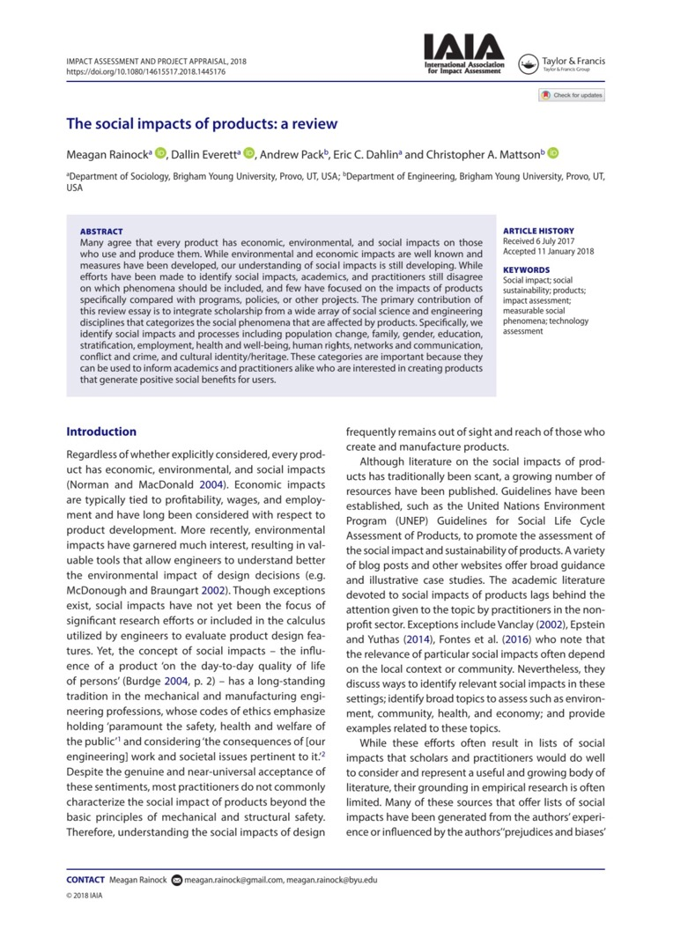
Rainock M, Everett D, Pack A, Dahlin EC, Mattson CA (2018), The social impacts of products: a review, Impact Assessment and Project Appraisal, 36:3, 230- 241,
DOI: 10.1080/14615517.2018.1445176
Notes:
https://doi.org/10.1080/14615517.2018.1445176
-By taking knowledge from social science and engineering literature, 11 social impact categories were identified from 121 papers, in 72 different sources

Slide 17




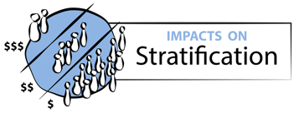
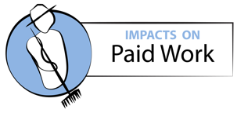
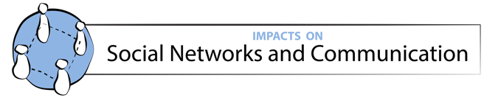

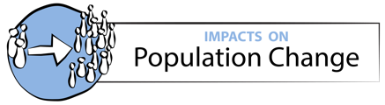


Social Impact Categories
Notes:
-The 11 social impact categories
-These categories may not be exhaustive and other categories may be thought of in the future

Slide 18



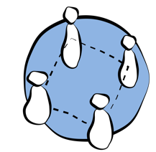

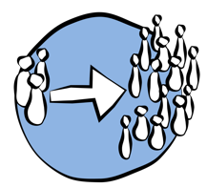




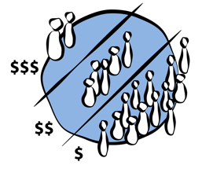
Examples??

Slide 19

Impact Stats:
Treated over 200,000 infants in 25 countries
Reduces treatment time by 40%
Consumes 70% less power than other common phototherapy devices
Secure living conditions
Safe living conditions
Safety and security (real and perceived)
Activity/exercise
Personal Mental Health
Personal Physical Health
Morality
Personal life/health improvement from product
Individual’s feelings from usage (frustration, positivity, etc.)
Individual’s perceived future opportunities/goals
Diet
DTM Firefly Infant Jaundice Lamp
Notes:
DTM Firefly
https://www.designthatmatters.org/firefly
5-10% of newborn infant mortality is due to jaundice
200,000 infants treated as of November 2018
40% reduction in treatment time is vs. single sided phototherapy. The DTM Firefly has LED’s on the top and bottom of the infant
Designed to be intuitive for rural areas where the training of health workers is limited

Slide 20

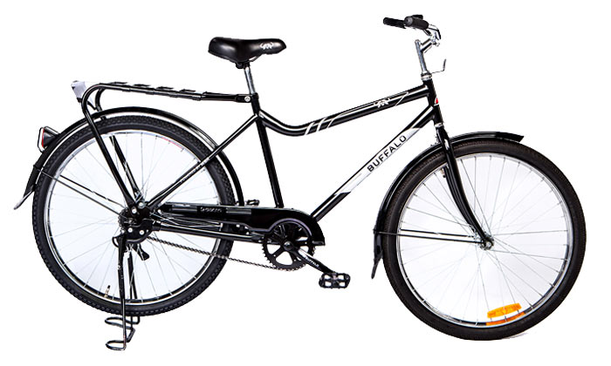
Impact Stats:
126,104 distributed to students
Attendance increases up to 28%
Academic performance increases up to 59%
Education and skills
Community empowerment and capacity building
Media and other access to information
Product Specific Training
Buffalo Bicycle
Notes:
The Buffalo Bicycle
https://worldbicyclerelief.org/en/
Link to their data: https://worldbicyclerelief.org/en/impact/education/

Slide 21

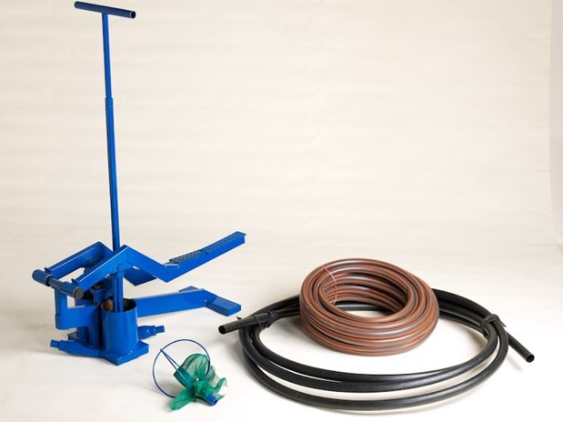
Impact Stats:
335,587 pumps sold
250,000 businesses created
$210 million annual new farm profits
and wages
Increase/decrease job opportunities
Industrial diversification/change of economic focus
Local business environment
Change in employment rates
Change in individual’s’ employment status
Money Maker Irrigation Pump
Notes:
Kickstart Moneymaker Pumps
http://kickstart.org/impact/#by-the-numbers
The average family business generates $850 in new net incomes and wages per year

Slide 22

Impact Stats:
16% crime reduction in experimental areas
51% crime reduction in parking lots
Potential conflicts
Homicide and violent crimes
Non-violent crimes
Corruption
Deviance from informal regulations/norms
Potential of assault or attack
Increased or decreased substance abuse
Individual noncompliance with rules
Security Camera
Notes:
Data source: https://www.tandfonline.com/doi/abs/10.1080/07418820802506206

Slide 23

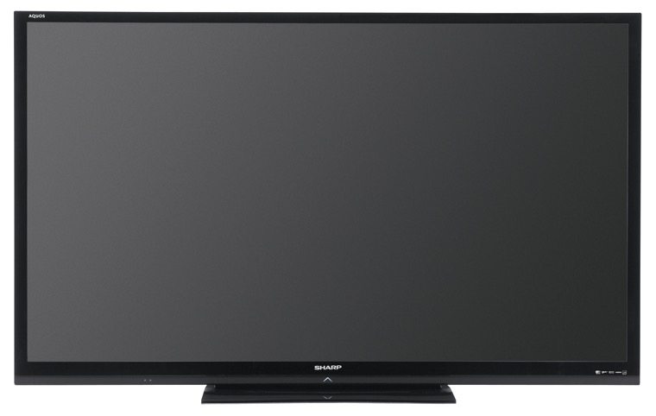
  Impact Stats:
  1.4 billion households own a television
  69% of households in LMIC countries have at least one television
  Can impact parent-child interaction
  10 countries watch an average of more than 3 hours of television per day
Alteration in family structure
Family roles
Family’s role in society
Family violence
Family Stressors
Changing family ties
Television
Notes:
69% of households in LMIC have at least one television https://www.tvtechnology.com/miscellaneous/the-state-of-television-worldwide
TV watching stats for selected countries https://www.statista.com/statistics/276748/average-daily-tv-viewing-time-per-person-in-selected-countries/
Television has negative impact on parent-child interaction https://www.sciencedaily.com/releases/2011/09/110914122317.htm

Slide 24

  Impact Stats:
  Last up to 10 years
  Can be left in place for 12 hours
  Compared to pads:
    5% of purchase cost
    0.4 % of the plastic waste
  Compared to tampons:
    7% of purchase cost
    6% of the plastic waste
Gender roles
Gender violence
Gender stressors
Gender inequality
Menstrual Cup
Notes:
Menstrual Cup (need image)
https://www.webmd.com/women/guide/menstrual-cup#1
Because it can last 10 years it will cut long term costs vs pads or tampons
It can be left in place for up to 12 hours without the risk of toxic shock syndrome like a tampon. This leads to women and girls to go about their day as normal.
“If compared with using 12 pads per period, use of a menstrual cup would comprise 5 percent of the purchase costs and 0.4 percent of the plastic waste, and compared with 12 tampons per period, use of a menstrual cup would comprise 7 percent of the purchase costs and 6 percent of the plastic waste.” -The Lancet Public Health journal
Global market valued at $995 million in 2016

Slide 25

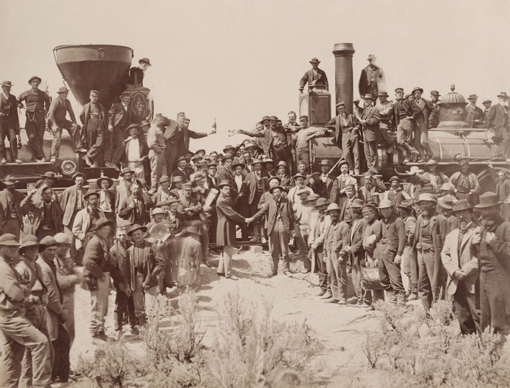
  Impact Stats:
  1,776 miles linked
  Route planning required no land disputes
  Led to pushing Native Americans back from the land through treaties and wars
  Numerous conflicts
Homeless rights
Disabled rights
Indigenous rights
Gender rights
Other minority rights
Democracy or decision making participation
Transcontinental Railroad
Notes:
Transcontinental Railroad
In order for a route to be considered for the transcontinental railroad there had to be no disputes to the land ownership. This led to pushing the Native Americans back from the land through treaties and wars, part of the broader effort to move them onto reservations.
The construction had numerous conflicts with Native Americans and wars.

Slide 26

  Impact Stats:
  Over 100 million units produced
  Sold in 160 Countries
  Designed for the masses
  Step-through design
  Ruggedized design for unpaved roads
  Affordable
Inequality between community and outside communities
Inequality within community
Social status indicators
Social mixing
Introduction of new classes or sub-communities (ex: gangs)
Personal prestige
Individual’s goals and future opportunities
Honda Super Cub
Notes:
Honda Super Cub. Most produced vehicle in history. As of 2017 100 million units have been produced
Designed for the masses. Easy step through design. Scooter wheels can’t handle the rough roads of developing countries, the Super Cub has the larger wheels of a motorcycle and can handle rougher terrain.
Semi-automatic centrifugal clutch made it easy to ride.
In 2008 a new one cost about $1,400. The 2019 anniversary model retails for $3,600. Sold in 160 countries.
https://global.honda/products/motorcycles/supercub-anniv/story/cub_special.html
2019 Honda Super Cub Pictured

Slide 27

  Impact Stats:
  250M Sold
  Keypad is dustproof and water resistant
  Facilitated Mobile Banking
  Facilitated Leap Frogging
Social capital
Networks (relations between actors)
Weakening or strengthening of relationships
How communication is carried out
Reliance on participation in the decision making process
Relationships between community actors
Impaired or improved personal relationships
Nokia 1100
Notes:
Nokia 1100
According to a 2007 Reuters article it was the top selling consumer electronics product. https://uk.reuters.com/article/us-nokia-history/nokias-cheap-phone-tops-electronics-chart-idUKL0262945620070503
https://gizmodo.com/the-most-popular-phone-in-the-world-5634258

Slide 28
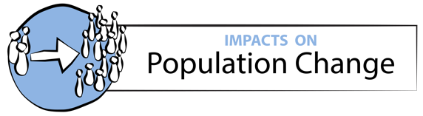
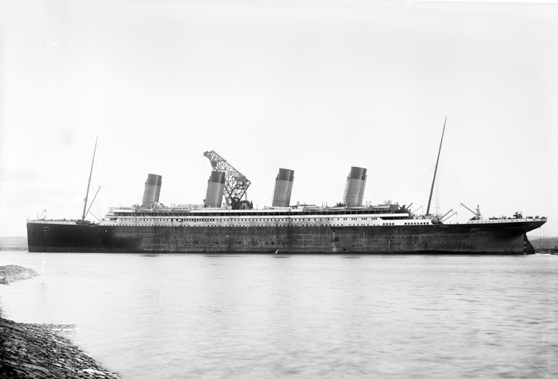
  Impact Stats:
  Reduced Atlantic crossing time by over 50%
  By 1870 90% of immigrants arrive in United States by Steamship
  Size of ships reduced travel cost
In/out migration; transiency of the population
Relocation of families
Presence of seasonal/leisure population
Introduction of new work population
Age structure of the community
Ocean Liner Steamship
Notes:
Ocean Liner Steamship
By 1870 90% of immigrants arrived by steamship
From 1870-1930 27 million people made the journey
The size of the ships allowed them to carry more people. The engines allowed the ships to complete voyages faster.
Sailing ships took about 6 weeks to get across the Atlantic, the steam ship was able to reduce this to 1-2 weeks

Slide 29

  Impact Stats:
  Grow to 272,000 units sold in 2022
  Open Heritage 3D has open source data sets for 79 sites
  Cultural sites threatened
  Aids in preservation and restoration
Weakening and strengthening of values
Cultural/ethnic/religious ideas and beliefs
Cultural intolerance
Cultural/religious rites and practices
Cultural/religious artifacts and places
Religious demographics
Individual identity reliant on cultural identity
Understanding of the universe and the role one plays in it
3D Scanner
Notes:
In 2022 it is projected that annual unit sales of 3D scanners will have grown to 272,000 https://www.idc.com/getdoc.jsp?containerId=prUS44619419
3D scans of the Notre Dame cathedral could help in reconstruction efforts https://www.technologyreview.com/f/613314/this-digital-scan-of-notre-dame-offers-hope-for-its-restoration-after/
Climate change, conflict and natural disasters threaten cultural sites around the world.
Organizations like Cyark are working to make 3D scans of cultural sites around the world.
Open Heritage 3D provides open source data for cultural sites.

Slide 30
Social Impact Categories

Slide 31











ACTIVITY 3
Purpose: Identify and consider possibly neglected impact categories
Tasks:
Considering the 11 social impact categories (below), choose 3 that you may not have considered before, that are potentially pertinent to your product.

Slide 32
ACTIVITY 4
Purpose: Further consider impacts in neglected areas.
Tasks:
Open the Social Impacts Consideration List, find and review the 5 questions posed for the 3 categories you selected in Activity 3.
Use the questions to prompt or inspire the identification of 2-4 specific impacts that you have not considered before but now believe should be addressed.

Slide 33
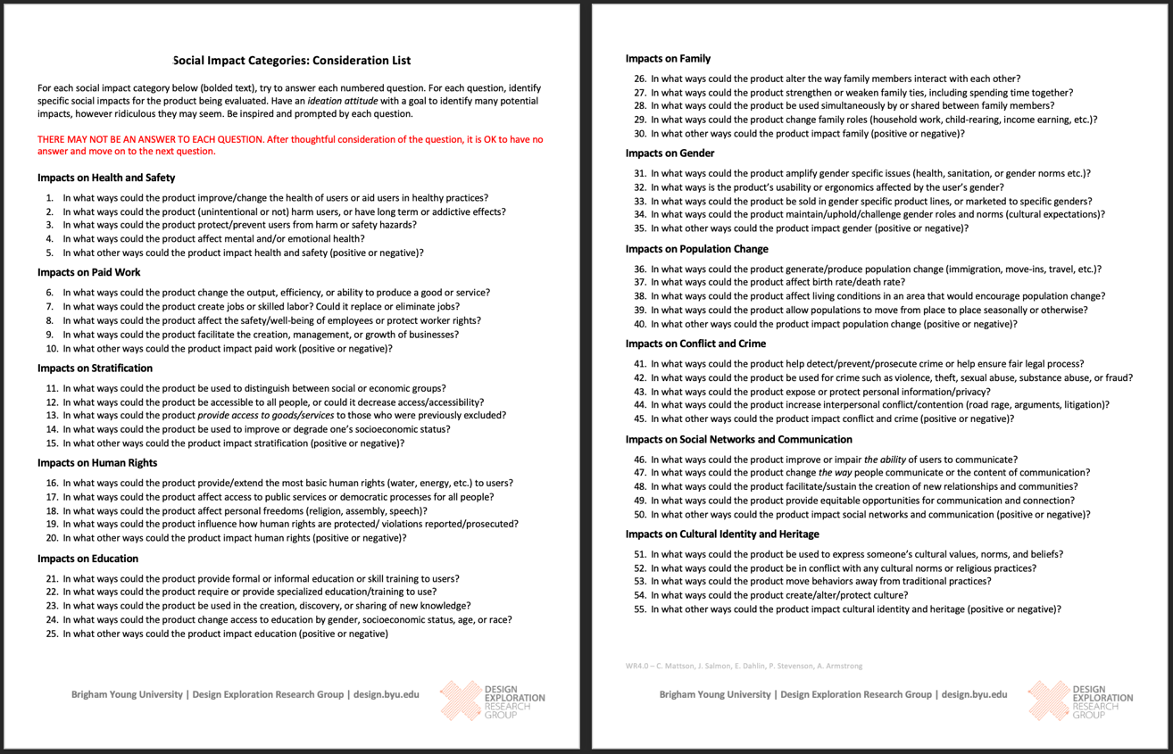
Notes:
This is the social impacts consideration list. It shows in bold, each of the 11 social impact categories. Then 5 questions are posed for each. These questions are designed to prompt thinking about impacts that may have otherwise been neglected. It is not important that all questions lead to pertinent impacts. It is important, however to consider which impacts are pertinent from various categories.

Slide 34
Notes:
We’ll zoom in on this part to get a better feel for what it is.

Slide 35
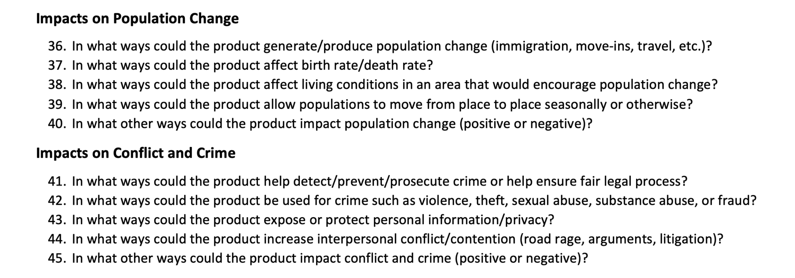
Notes:
Reading this is good to help consider what population change might mean and how conflict and crime may be impacted by the product.

Slide 36
ACTIVITY 4
Purpose: Further consider impacts in neglected areas.
Tasks:
Open the Social Impacts Consideration List, find and review the 5 questions posed for the 3 categories you selected in Activity 3.
Use the questions to prompt or inspire the identification of 2-4 specific impacts that you have not considered before but now believe should be addressed.

Slide 37
PART 1
Short Orientation
PART 2
Impact Activities (4)
PART 3
Workshop Materials

Slide 38
Baraza Goal #2
To provide you with the materials to bring these ideas to your classroom/teams
To support this:
We have workshop materials available to you at design.byu.edu
  The slides from this workshop (with presenter notes), for your use
  Social Impacts Consideration List (PDF)
  References to pertinent literature

Slide 39
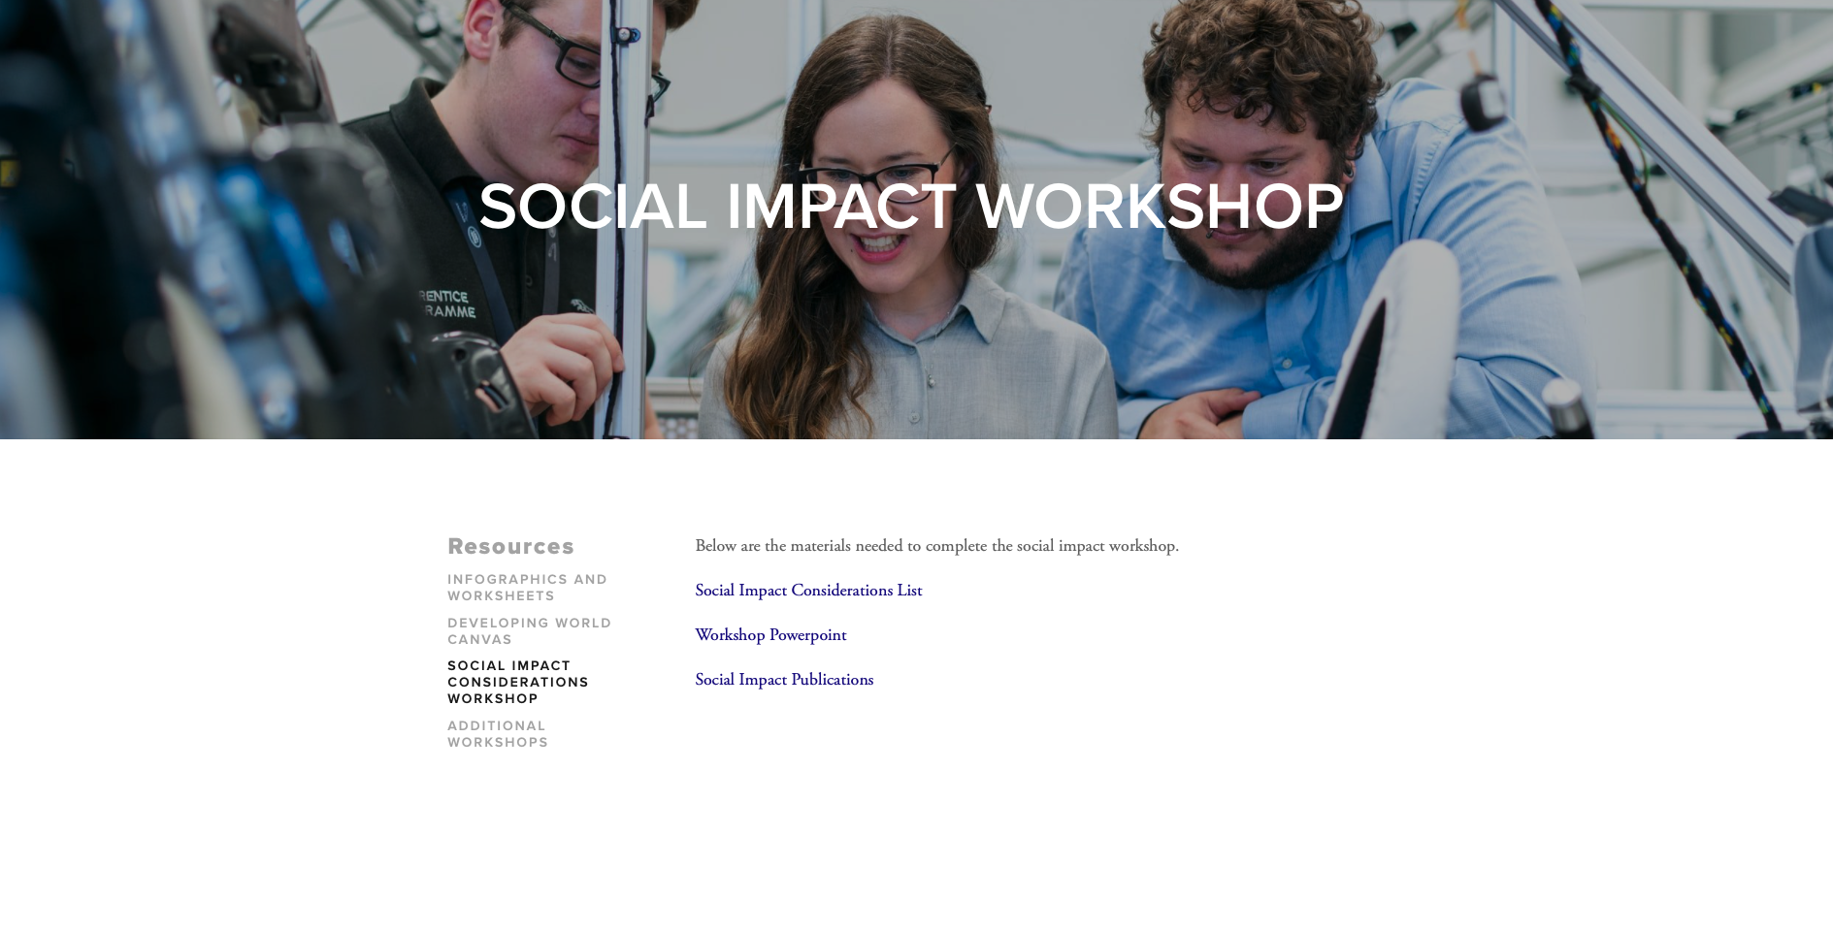
https://www.design.byu.edu/socialimpact-workshop

